Slide 1
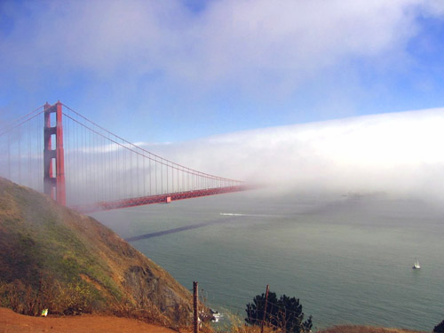
Employees’ Association
Bay Area Air Quality Management District
Special General Membership Meeting
June 3, 2021

Slide 2
Contract Negotiation
Sec 7.01 Salaries
2 Year Contract - July 1 2021– June 30 2023
1st year; 1.5% COLA - .75% July 4th 2021, .75% Jan 2nd 2022
2nd year; COLA 1% – 3.4%
2

Slide 3
Contract Negotiation
Side Letter Regarding MOU Sec 8.04 Performance Evaluations
3rd Party to review performance eval. In conjunction a sliding classification will be implemented
3

Slide 4
Contract Negotiation
9.04 Overtime
Comp time outside of your regular division is subject to manager approval
4

Slide 5
Contract Negotiation
Sec 11.06 Insurance After Retirement
Removed “At a minimum” from “The District shall comply with the provisions of the California Public Employees’ Medical and Hospital Care Act."
5

Slide 6
Contract Negotiation
11.15 Job Related Education
Created a Student Loan Repayment Program
Reallocated funds so its 10k per pot
6

Slide 7
Contract Negotiation
12.01 Annual Leave
Increase annual leave cap to 550 hours till June 30, 2023
Removed language where future permanent employee that were previously employed as a LTE/temp for more than 1000 hours accumulated service shall be the combined service as a permanent employee.
Removed language If a payday falls during an employee's vacation, the employee may receive a partial pay warrant for the pay period.
Changed the time allowed for payment for unused annual leave from 10 to 15 days
Employees who are rehired after 5 years of separation don’t retain same annual accrual rate
7

Slide 8
Contract Negotiation
12.02 Sick Leave
Dr. note may be required after 5 consecutive scheduled work days of calling out sick
Added “full time” and “part time” to allowance and accrual rate
8

Slide 9
Contract Negotiation
12.06 Subpoena As A Witness
Added language “on matters related to District business”
9

Slide 10
Contract Negotiation
Sec 12.07 Holidays
Extended float hours expiration date to 9/30/21
Allow cash out of unused float leave
10

Slide 11
Contract Negotiation
16.02 Contracting Out
Increase pot from 17k to 22k for each year of the 2 year contract
Will automatically revert to 3.8% of filled bargaining unit positions
Example : (250 x 2080) x 3.8%=19,760 pot of Temp hours
11

Slide 12
Contract Negotiation
Section 16.03 Intern and Fellows Program
Created a fellows program Limited to 2000 hours
Changed college intern pay to Office Assistant I step A pay
Change frequency of reporting to quarterly
Removed some language from misc. section
12

Slide 13
Contract Negotiation
Reclass and Equity adjustment
Current Classification | Current Salary Range | Proposed Classification | Proposed Salary Range
Air Quality Inspector I | 124 | Assistant Air Quality Specialist II | 126
Air Quality Inspector II | 128 | Air Quality Specialist I | 130
Senior Air Quality Inspector | 132 | Air Quality Specialist II | 134
Supervising Air Quality Inspector (no incumbents) | 136 | Senior Air Quality Specialist | 138
Air Quality Instrument Specialist I | 124 | Assistant Air Quality Specialist II | 126
Air Quality Instrument Specialist II | 128 | Air Quality Specialist I | 130
Senior Air Quality Instrument Specialist | 132 | Air Quality Specialist II | 134
Principal Air Quality Instrument Specialist | 136 | Principal Air Quality Specialist | 142
Supervising Air Quality Instrument Specialist | 136 | Supervising Air Quality Specialist | 142
13

Slide 14
Contract Negotiation
Reclass and Equity adjustment
Current Classification | Current Salary Range | Proposed Classification | Proposed Salary Range
Air Quality Chemist I | 127 | Air Quality Chemist I | 130
Air Quality Chemist II | 131 | Air Quality Chemist II | 134
Senior Air Quality Chemist | 135 | Senior Air Quality Chemist | 138
Principal Air Quality Chemist | 139 | Principal Air Quality Chemist | 142
Accounting Assistant I | 106 | Accounting Assistant I | 112
Accounting Assistant II | 110 | Accounting Assistant II | 116
Senior Accounting Assistant | 114 | Senior Accounting Assistant | 120
Accountant I | 123 | Accountant I | 126
Accountant II | 127 | Accountant II | 130
Principal Accountant | 135 | Principal Accountant | 138
Fiscal Services Coordinator | 139 | Fiscal Services Coordinator | 142
Public Information Officer I | 127 | Public Information Officer I | 130
Public Information Officer II | 131 | Public Information Officer II | 134
Senior Public Information Officer | 135 | Senior Public Information Officer | 138
Supervising Public Information Officer | 139 | Supervising Public Information Officer | 142
14

Slide 15
Questions?
15

